Slide 1
SMART TRAFFIC CONTROL USING DEEP LEARNING
Guide
Mr. J. S. Pujari Sir
Prepared by,
Chintamani Naik
Yash Mudgal
Nikhil Patil
Vivek Patil
Sandeep Pandita

Slide 2
Outline
Introduction
Objectives
Product Functions
Methodologies
Implementation
Conclusion

Slide 3
Introduction
This project is a concept of dynamic traffic signal
Existing System of Traffic Signal Control
The amount of time wasted in traffic signals is a huge problem for productivity. To avoid this problem we have designed an Intelligent Traffic System where the amount of time spent at the junction is reduced. For example: If there is a junction with four roads, the green signal remains for about 60 seconds in one particular lane, while the other three lanes remain in red. The cycle continues in every lane hence making a total time of 60 * 4 = 240 seconds. Now by Smart traffic control if there is more traffic on one particular road, there we will be an increase of the green signal time for an extra 9 seconds so it gets 69 seconds and other sides will get 57 seconds each (extra 9 seconds is divided to the other three lane) so that the total round off time is constant (I have taken one case so far, there might be cases where there will be traffic in two or more roads, as well).
Proposed as a solution to the conventional problem of
Fixed traffic signal regulations and time.
The problems faced by its manual behavior.

Slide 4
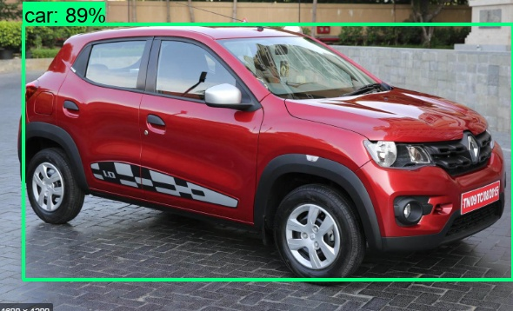
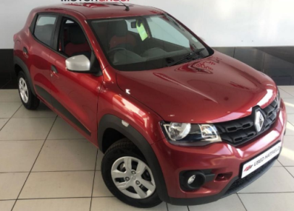
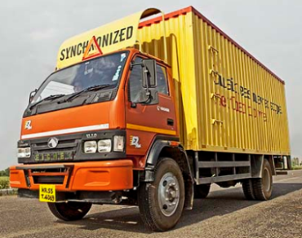
Introduction
Classification
Car Truck
Object Detection
Car
one image -> one label
one image -> labels + bounding boxes

Slide 5
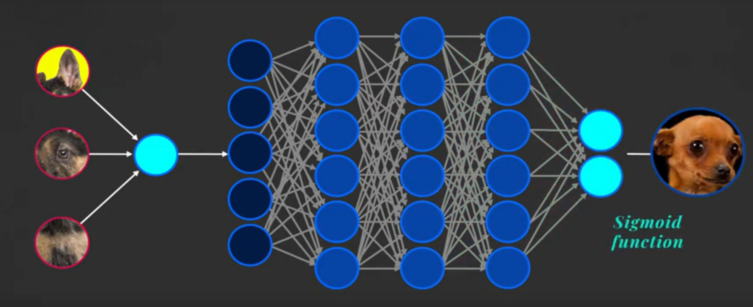
CNN Architecture

Slide 6
Objectives
Creating and training custom object detection model using deep learning
Identifying exact position of a vehicle present in a frame and count number of vehicles
Detection of vehicles in a live video stream
Get signal time and traffic information and process them to generate new signal time allocation scheme

Slide 7
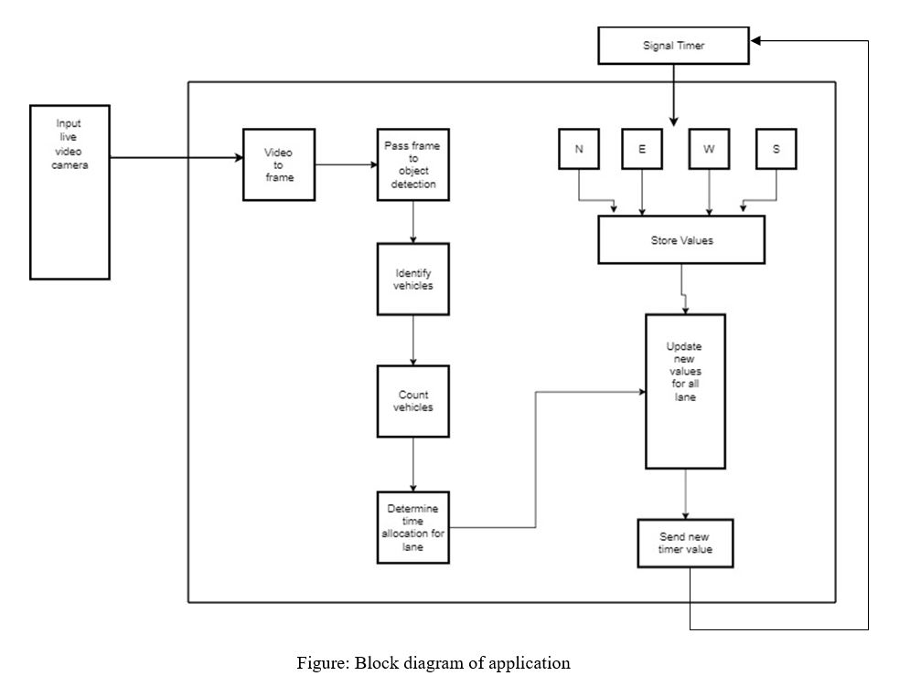
Product Functions

Slide 8
Methodologies
1. Gathering images of different vehicles
2. Images are processed and parameters are collected accordingly.
3. Result set is generated based on processed images for the parameters that can be used to classify different types of vehicles.
4. Input new image or video to be checked.
5. Inserted image or video is then compared with the generated result set and the report is generated.

Slide 9
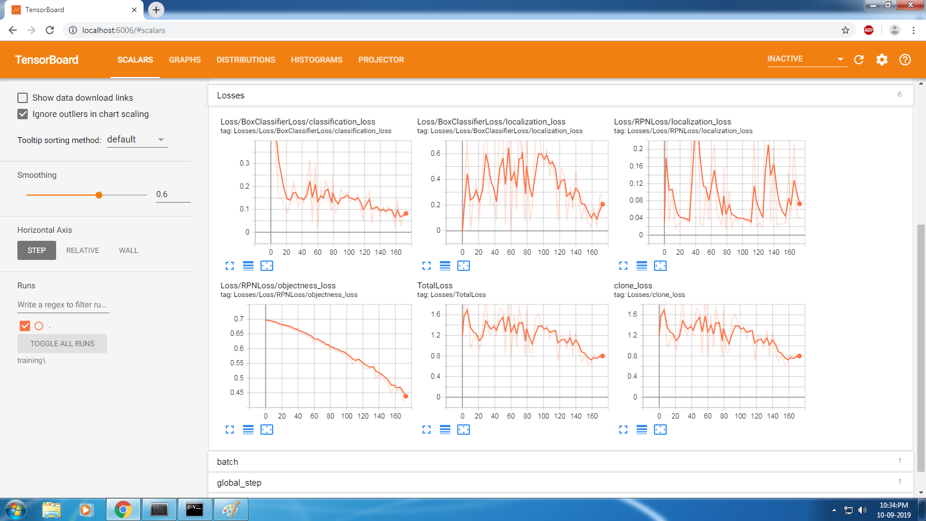

Slide 10
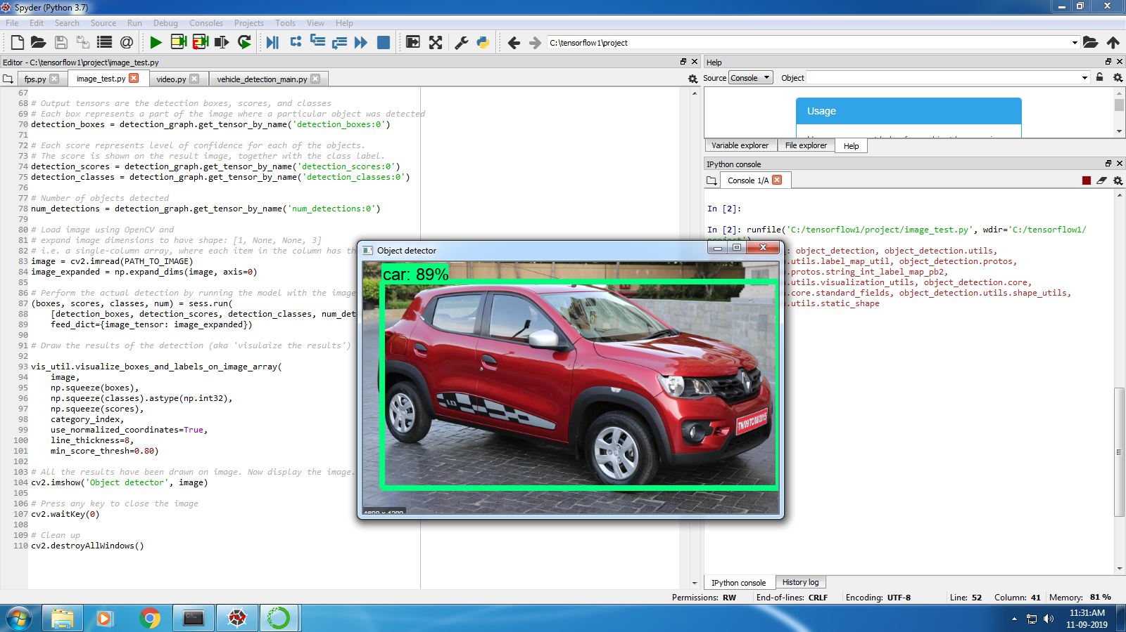

Slide 11
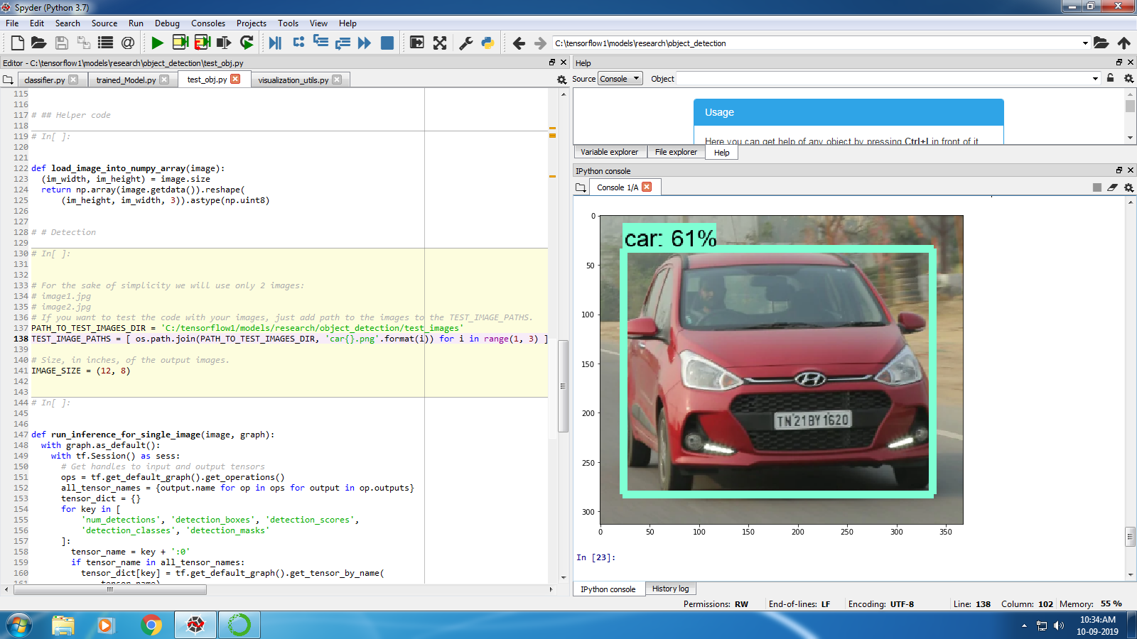

Slide 12
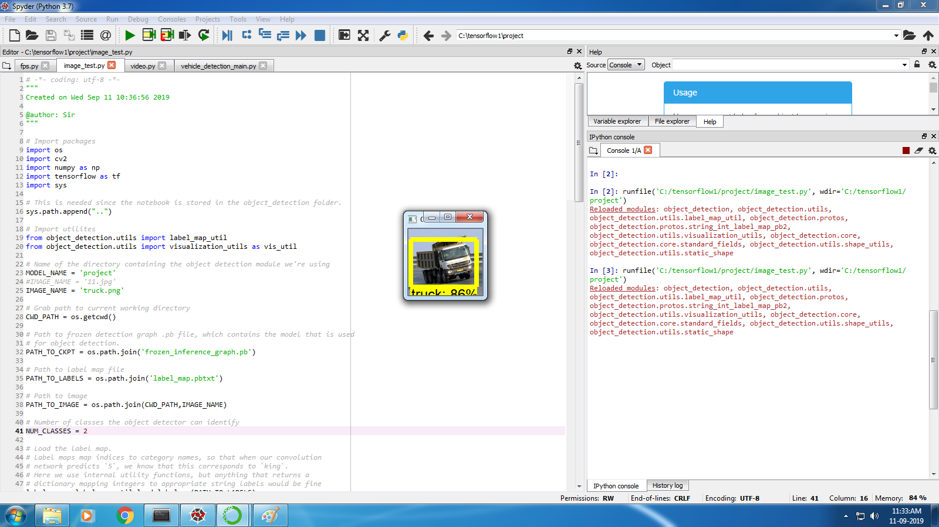

Slide 13
Conclusion
This Faster R-CNN for Real Time Traffic Signal Control works almost flawlessly with the hybrid multi-agent system, and is capable of easing the load of traffic control from Government bodies by automating the process.

